Slide 1

Python Advanced
Course Introduction
SoftUni Team
Technical Trainers
Software University
https://softuni.bg/

Slide 2
Table of Contents
Course Objectives
Training and Team
Course Organization
Course Infrastructure
Evaluation Criteria
2

Slide 3
Have a Question?
sli.do
#python-advanced

Slide 4













SoftUni Diamond Partners

Slide 5

Course Objectives

Slide 6
Python Advanced Objectives
Working with Lists as Stacks and Queues
Working with Tuples and Sets
Creating and working with Multidimensional Lists
Learn functional programming
Working with Files
Handling Exceptions
6

Slide 7
Practical Programming Exam
Exam – 4 hours
3 practical problems
Stacks and Queues
Multidimensional Lists
Functions
7

Slide 8
Theoretical Exam
You will have 30 minutes once you enter
Multiple-choice with 1 correct answer
Test will be in English
Automated quiz system
Available on the day of the practical exam
You can submit your answers just one time
8

Slide 9

The Team

Slide 10
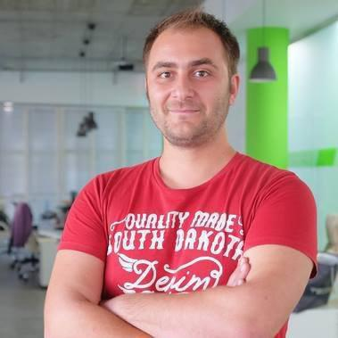
Doncho Minkov
Technical Lead & System Architect in SoftUni
10+ years in IT
8+ years of experience as a
Technical Trainer @ Telerik Academy
Front-end developer by heart
Software developer by need
Huge experience in web development:
Django, ASP.NET, Node.JS, Spring
Fluent in Python, .NET, Angular, Java, C++ and mobile
"30 under 30" – Forbes 2017 - Education

Slide 11
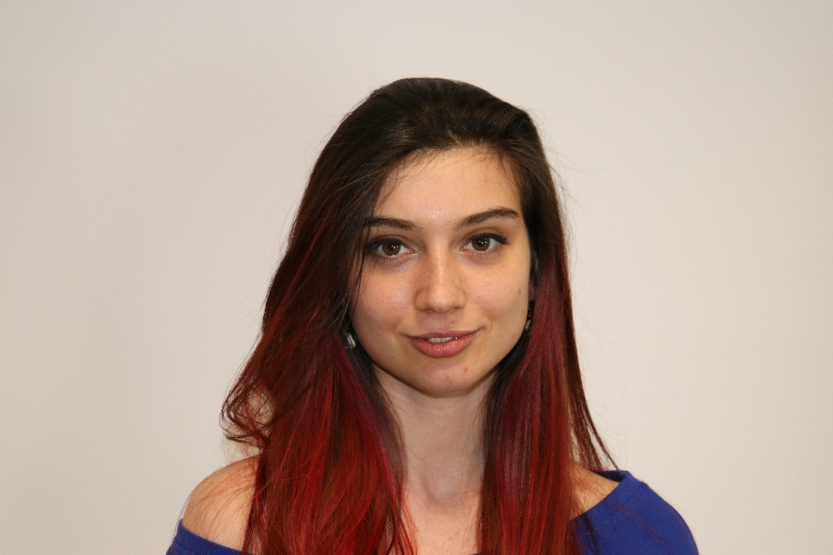
Ines Ivanova
Python web developer at IQVIA
Full stack freelance developer
Python, Django, C#, Angular, HTML,
CSS, jQuery, Flask

Slide 12

Course Organization

Slide 13
Python Advanced Course
11-Jan-2021
14-Feb-2021
14-Apr-2021
Python Advanced
5 weeks * 4 times / week
12 credits
Start: 11-Jan-2021
Theoretical Exam: 14-Feb-2021
Final exam: 14-Feb-2021
Re-Take Exams
Theoretical Exam: 14-Apr-2021
Final Exam Retake : 14-Apr-2021

Slide 14

Homework Assignments & Exercises
Your homework is mainly work in class
Lesson days → slides + live demos + exercises
Exercise days → only exercises
How to submit your homework?
Submitted in the judge system
Do your homework when it's due
Assignments pile up quickly

Slide 15


SoftUni Certificate
Practical Exam 100%
Homework 5%
Evaluation
15

Slide 16
CPE Certificate
Theoretical Exam 100%
Evaluation
16

Slide 17


Course Web Site, Forum and FB Group
Official web site:
Softuni Python Community group:
https://softuni.bg/trainings/3219/python-advanced-january-2021
https://www.facebook.com/groups/SoftUniPythonCommunity

Slide 18
Questions?
Notes:
18

Slide 19
Trainings @ Software University (SoftUni)
Software University – High-Quality Education, Profession and Job for Software Developers
softuni.bg, softuni.org
Software University Foundation
softuni.foundation
Software University @ Facebook
facebook.com/SoftwareUniversity
Software University Forums
forum.softuni.bg
19
Notes:
19

Slide 20

License
This course (slides, examples, demos, exercises, homework, documents, videos and other assets) is copyrighted content
Unauthorized copy, reproduction or use is illegal
© SoftUni – https://about.softuni.bg
© Software University – https://softuni.bg
Notes:
20

